Slide 1

CS-145
Spring 2014
Frieze step pattern
Professor Jenny Orr
Dept of Computer Science
gorr@willamette.edu

Slide 2
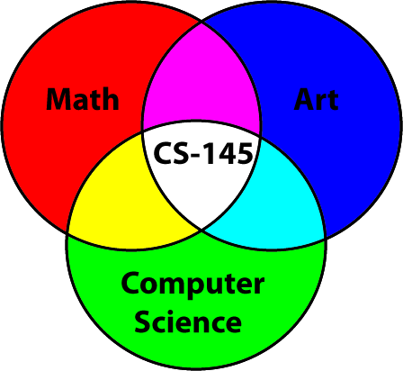
What is this Course About?
Algorithmic Art
Satisfies QA*
The focus is programming and math in the context of visual art.

Slide 3
What is Processing?
Processing is an open source programming language and environment
for people who want to create images,
animations, and interactions.
[processing.org]
Iterated function system

Slide 4

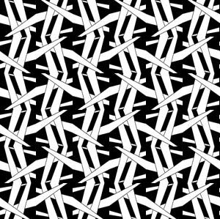
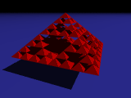
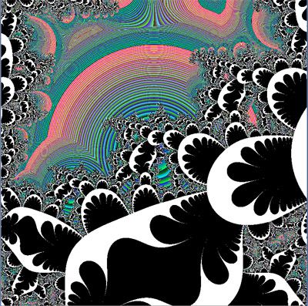
Processing is Good for:
Art Creation
Exploration
Scientific & Mathematical Visualization → Understanding

Slide 5
When to use Processing
Processing is great for rapidly writing small programs that involve any sort of visualization, 2D or 3D.
Easy to:
  Create a drawing window.
  Write code without a lot of overhead.
  Read, manipulate, and save images.
  Generate animations.
  Apply transformations.
  Interact with user via key and mouse
  Convert programs to javascript for running on web.
Rotate Dots
Example
Trigonometric functions

Slide 6
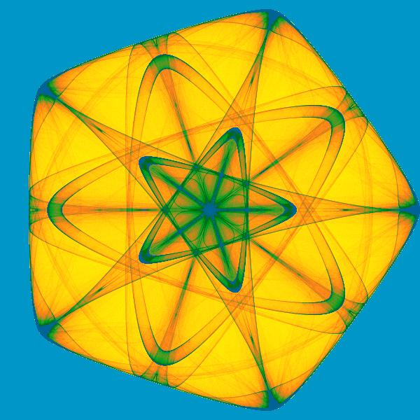
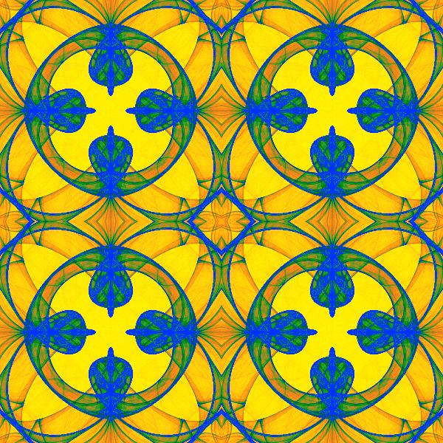
Pushing the limits of Processing
Processing may be slow or difficult to apply for programs that:
Have a complex structure
Involve large amounts of data
Have complex user interaction.
Are not visually oriented.
Iterated
function
system

Slide 7

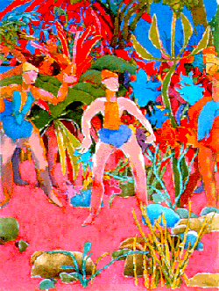
Algorithmic Art
What is an Algorithm?
In the logician's voice:
  An algorithm is
  a finite procedure,
  written in a fixed symbolic vocabulary,
  governed by precise instructions,
  moving in discrete steps, 1, 2, 3,...,
  whose execution requires no insight, cleverness,
  intuition, intelligence, or perspicuity,
  and that sooner or later comes to an end.
From The Advent of the Algorithm, by David Berlinski
Janet Parke, Souls Bend, Hearts Break
Harold Cohen,
Painting by AARON

Slide 8
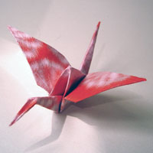
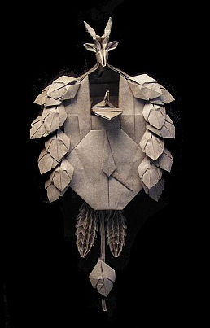
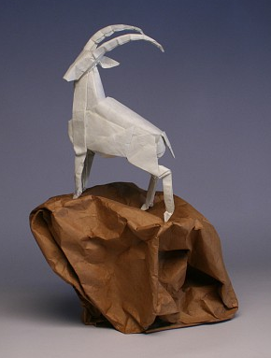
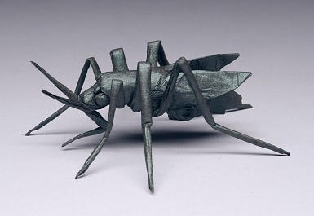
Origami
Origami Crane Instructions:
http://www.origami-fun.com/support-files/origami-crane-print.pdf
Origami and Math: Robert Lang TED talk:
http://www.ted.com/talks/robert_lang_folds_way_new_origami.html

Slide 9
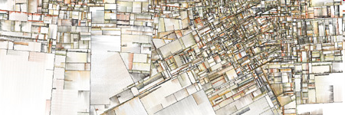
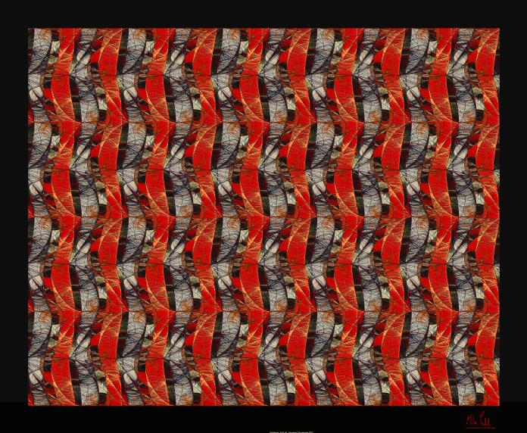
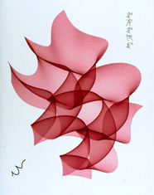
Art Creation
Jared Tarbell, Substrate 2003, http://www.complexification.net/gallery/
Mike Field,
Firestorm 2001
http://www.math.uh.edu/~mike/ag/recent/recent.html
Also,
see examples on Hello Processing
Roman Verostko
Cyberflower Red 2002
http://www.verostko.com/gallery.html

Slide 10
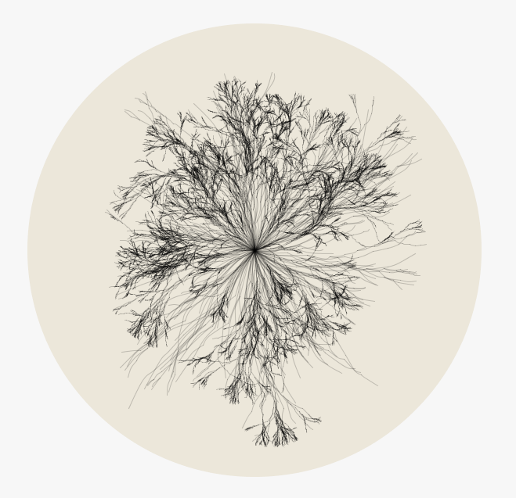
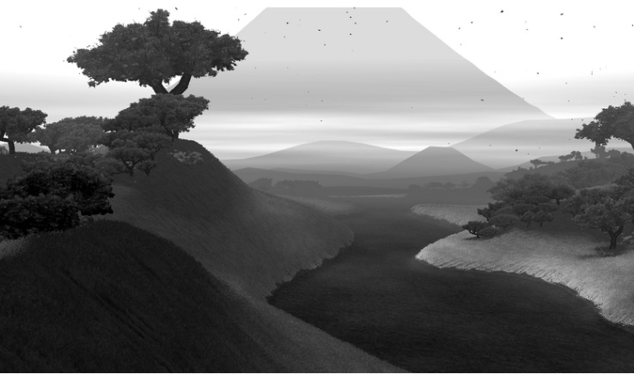
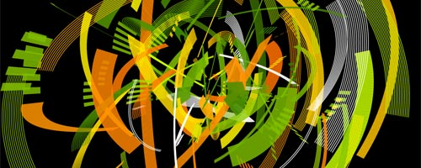
Processing Art Examples
Lots are online, e.g.
  http://processing.org/exhibition/
  http://www.openprocessing.org/
Books:
  Generative Art, http://zenbullets.com/books.php,
  Matt Pearson
  Form + Code, http://formandcode.com/, Casey Reas, Chandler McWilliams, LUST
Diana Lange
Marius Watz
Robert
Hodgin

Slide 11
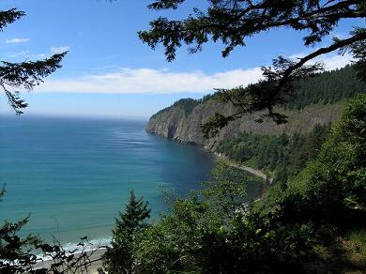
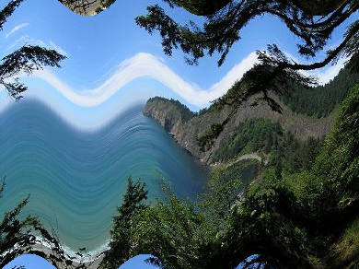
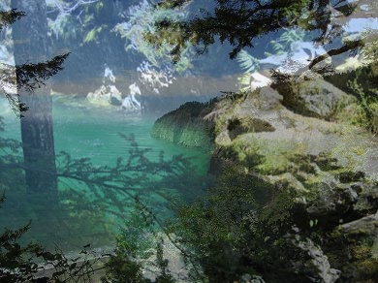

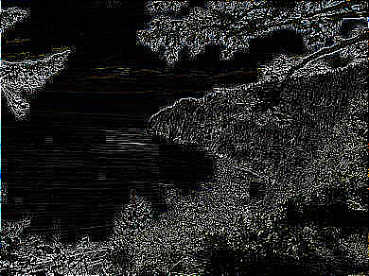
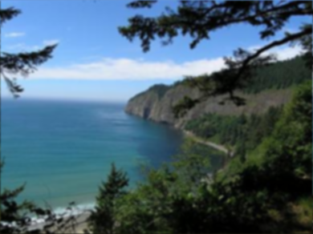
Image Manipulation

Slide 12
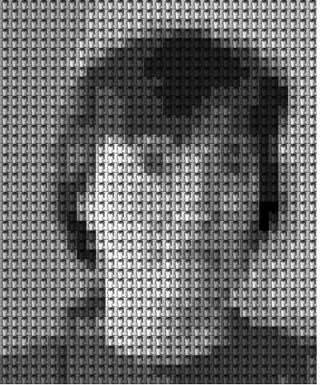
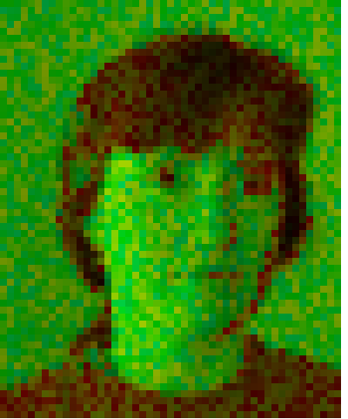

Image Manipulation

Slide 13
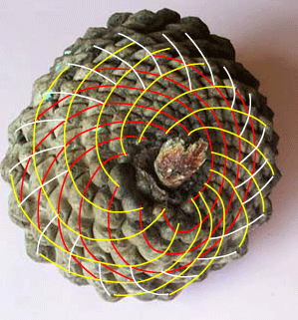
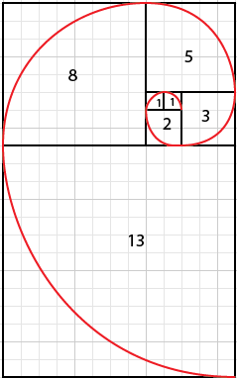
Science
Phyllotaxis (Leaf Arrangement):
Pine Cones, Cacti, & Fibonacci Numbers
Red: 8
Yellow: 13
White: 21
Fibonacci Sequence:
0 1 1 2 3 5 8 13 21 34 55 89 …
Image taken from: http://faculty.smcm.edu/sgoldstine/pinecones.html
Also see:
http://www.maths.surrey.ac.uk/hosted-sites/R.Knott/Fibonacci/fibnat.html#plants

Slide 14
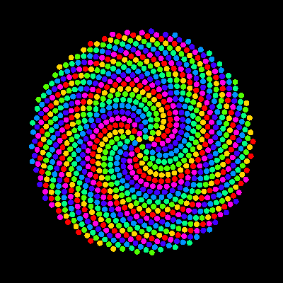
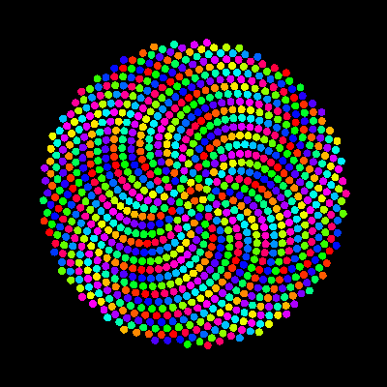
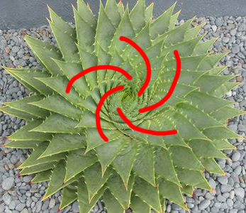
Phyllotaxis & Processing
Fibonacci Sequence:
0 1 1 2 3 5 8 13 21 34 55 89 …
Phyllotaxis
Example
21
34
5
“Divergence angle” = angle between leaves = 360/tau = 222.5 (or 137.5◦)
where tau=golden ratio

Slide 15
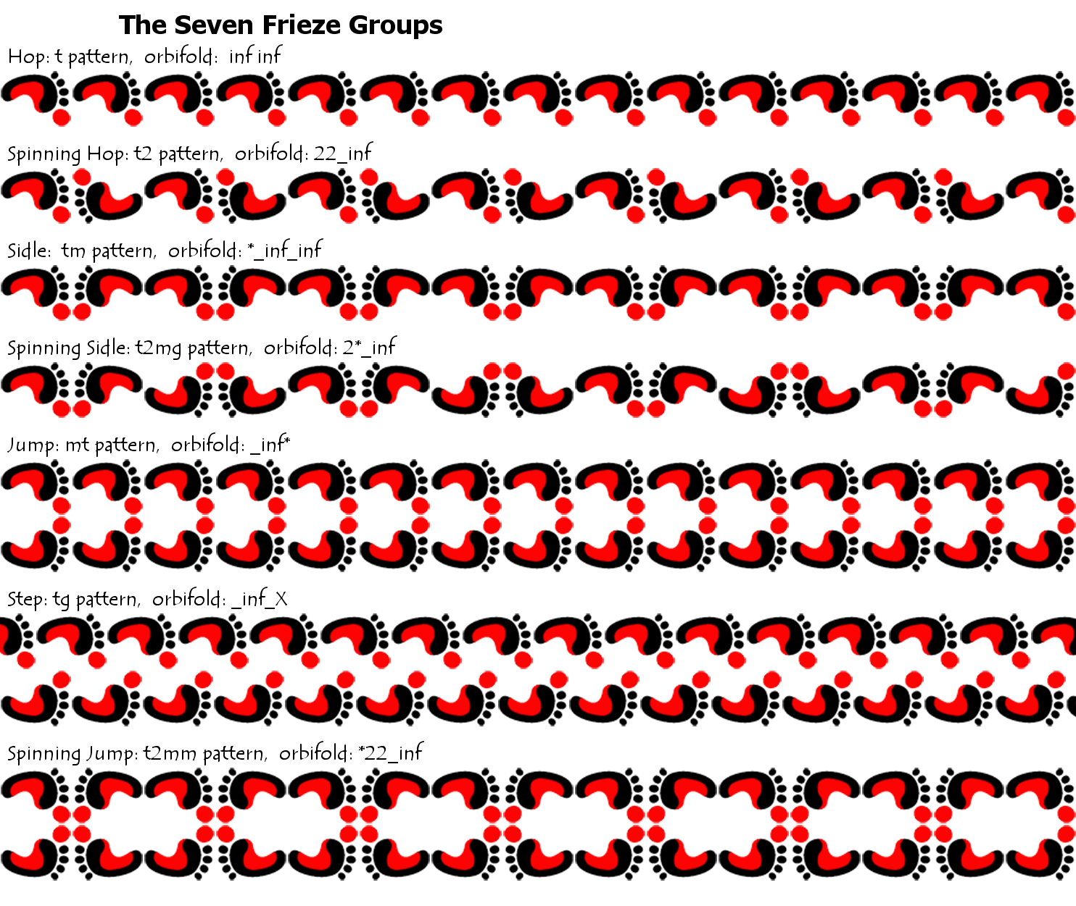
Understanding Transformations and Symmetry: Frieze Patterns
See FriezePatterns
example
(via Processing)

Slide 16
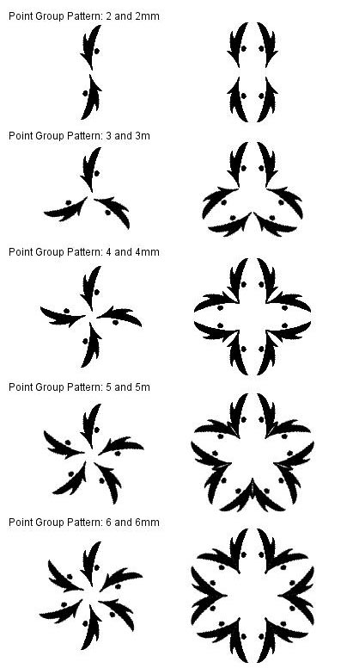
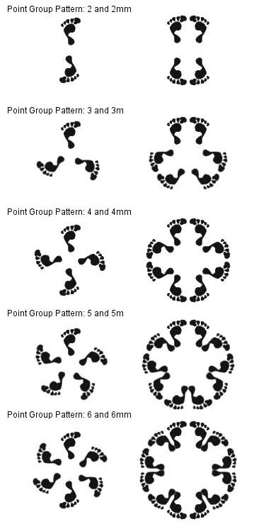
Symmetry: Point Group

Slide 17
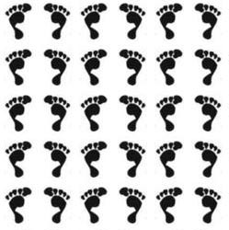
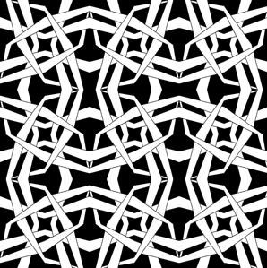
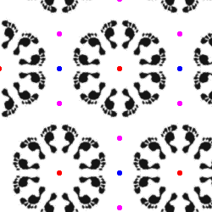
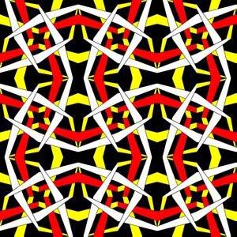
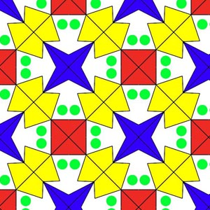
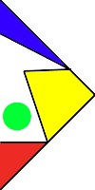
Symmetry : Wallpaper Group

Slide 18
Math: Complex Numbers
Physics: AC circuits, quantum mechanics
Mathematics: Solutions to cubic and quartics
Art & Science: Fractals
Computer Graphics Transformations:
  Complex numbers → 2D Rotations
  Quaternions → 3D Rotations
“So, progresses arithmetic sublety the end of which, as is said, is as refined as it is useless.” Cardano (1501-1576)

Slide 19
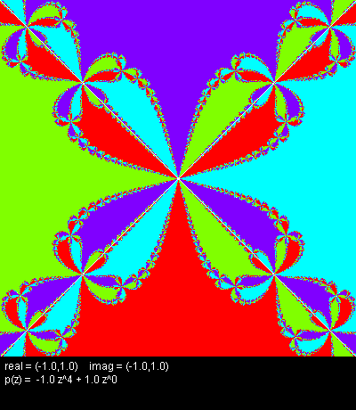
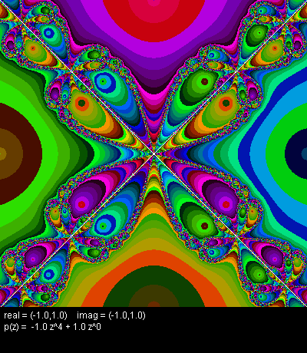
Math: Polynomiography
Formally, polynomiography is the art and science of visualization in approximation of zeros of polynomials. This visualization is via fractal and non-fractal images created based on the mathematical convergence properties of iteration functions. [http://www.polynomiography.com/about.php]
P(z) = - z⁴ + 1
Roots: 1, -1, i, -i

Slide 20
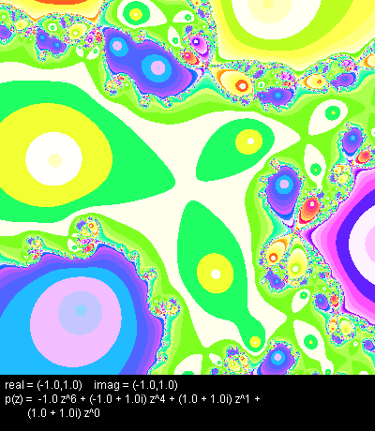
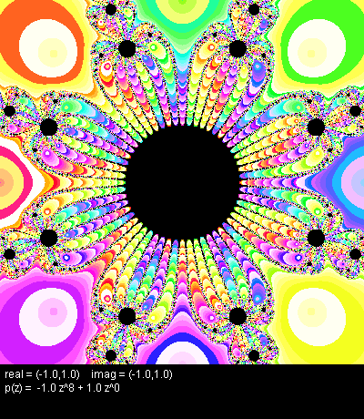
Polynomiography
P(z) = - z⁶ + (-1 + i) z⁴ + (1 + i) z + (1 + i)
P(z) = - z⁸ + 1

Slide 21
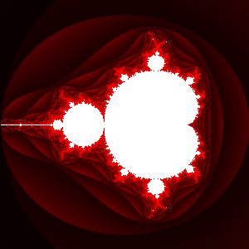
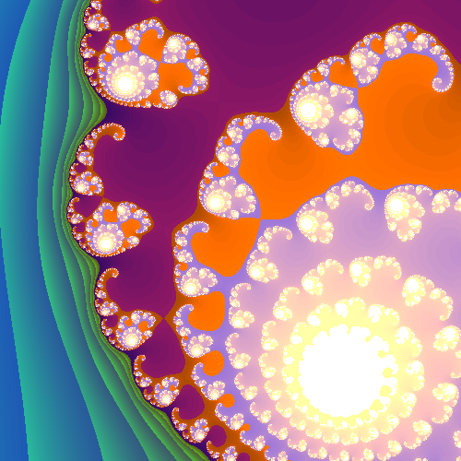
Fractals
Mandelbrot and Julia Sets:
Iterate: z_{n} = z²_{n-1} + c
What is happening?

Slide 22
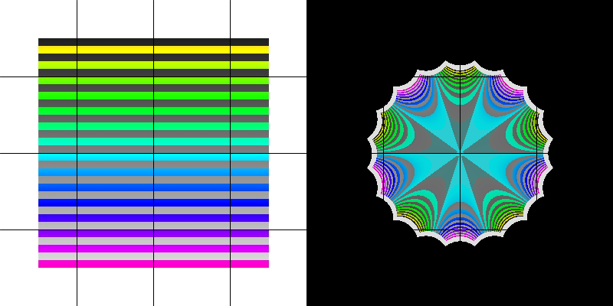
Example: z → z⁵
-2 < x < 2, -2 < y < 2

Slide 23
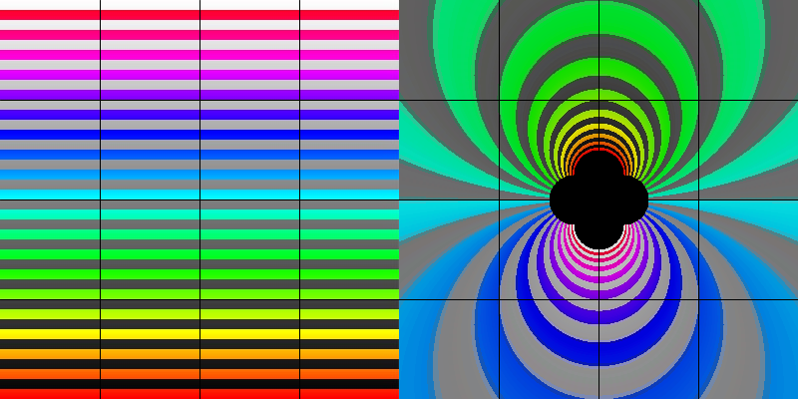
Example: z →1/z
-2 < x < 2, -2 < y < 2

Slide 24
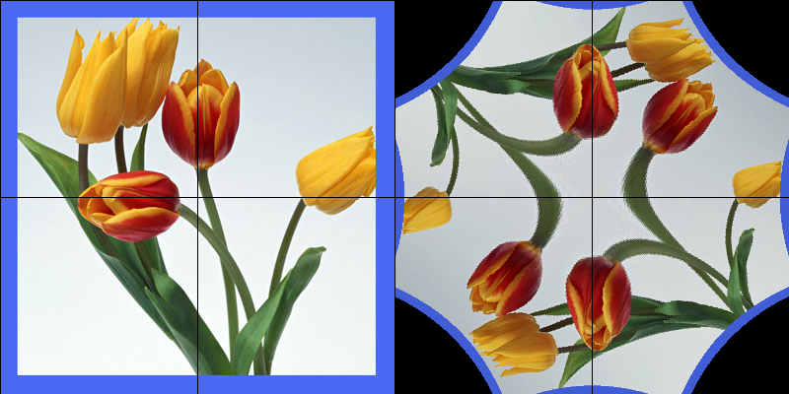
Example: z → z²
-1 < x < 1, -1 < y < 1

Slide 25
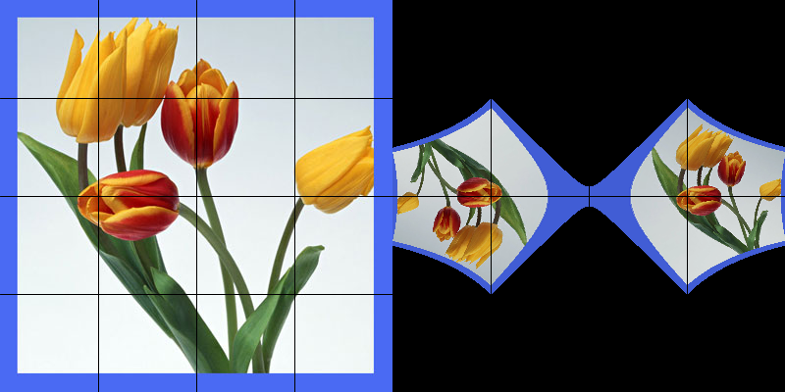
Example: z → z² - 2
-2 < x < 2, -2 < y < 2

Slide 26
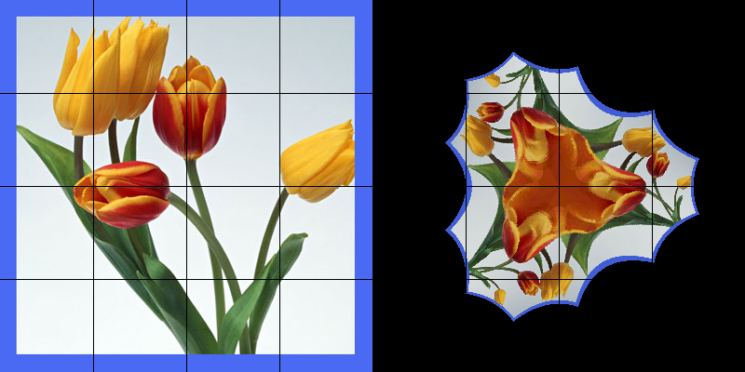
Example: z → z³ - 1
-2 < x < 2, -2 < y < 2

Slide 27
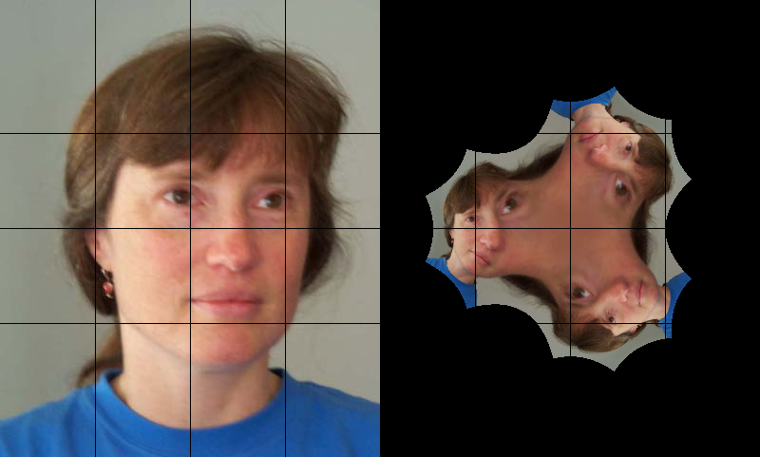
Example: z → z³ + 1
-2 < x < 2, -2 < y < 2

